Slide 1
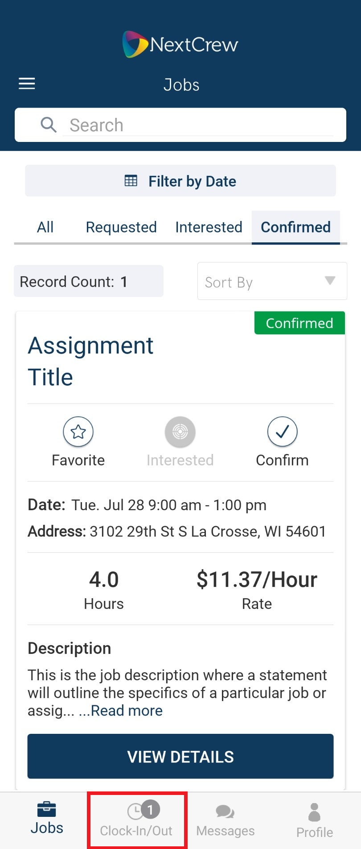
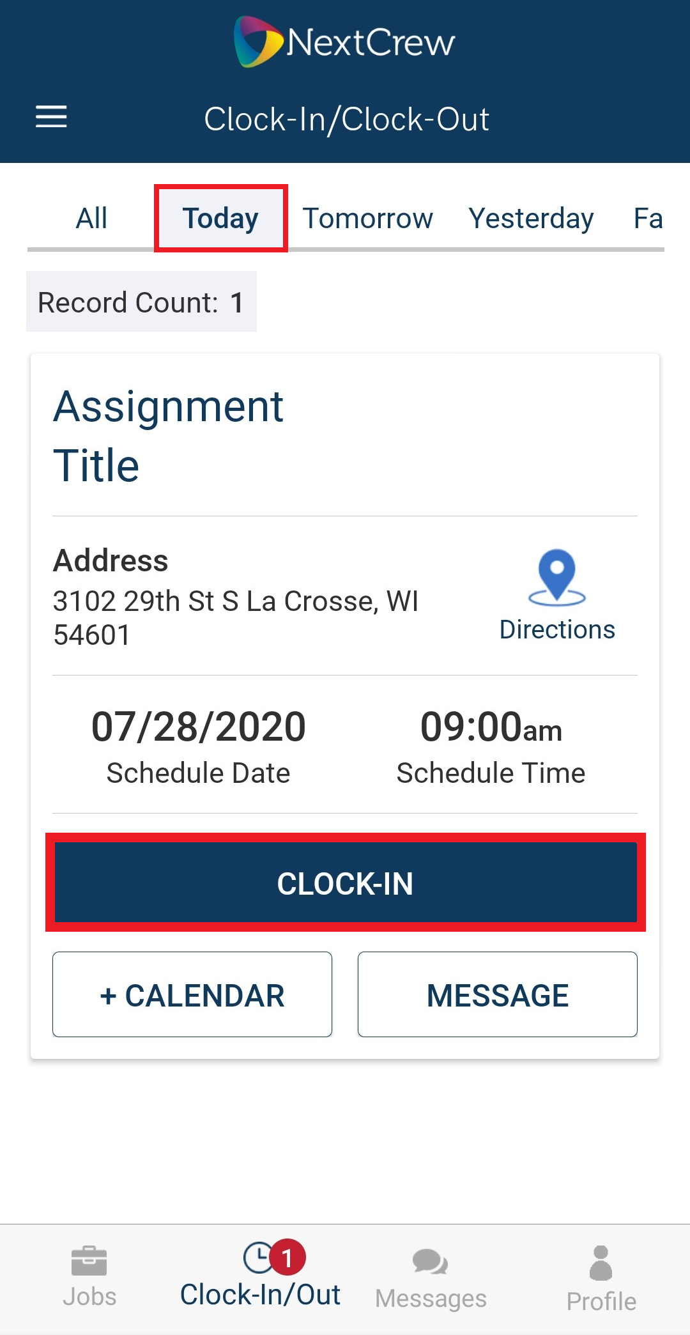
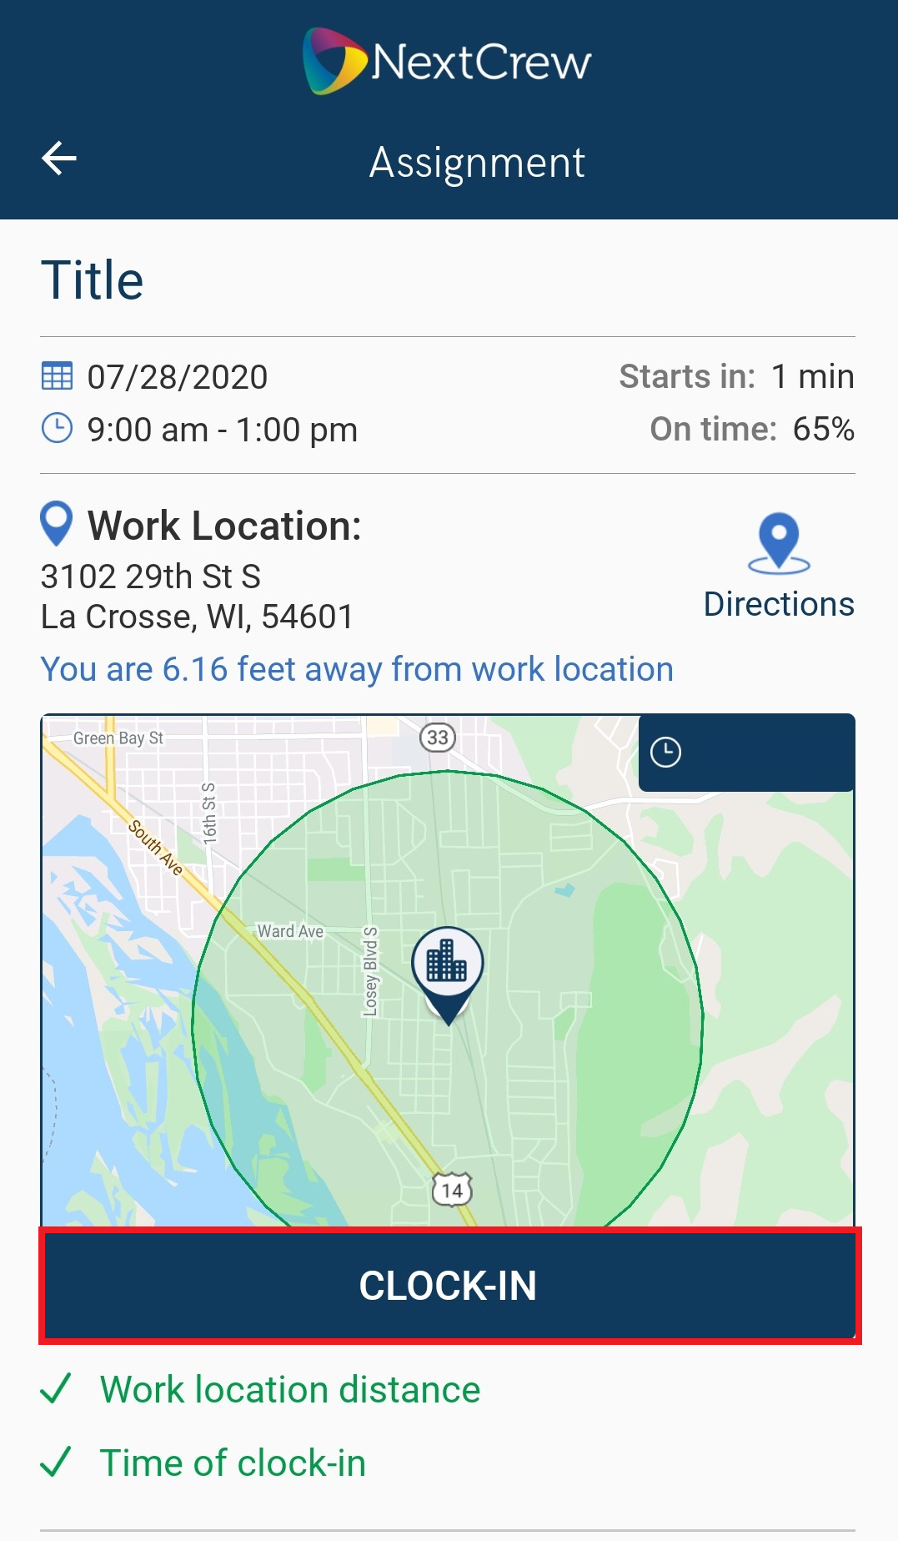
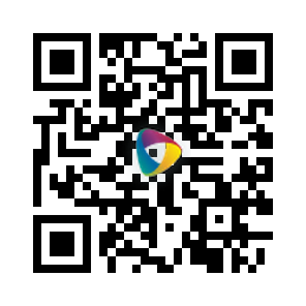
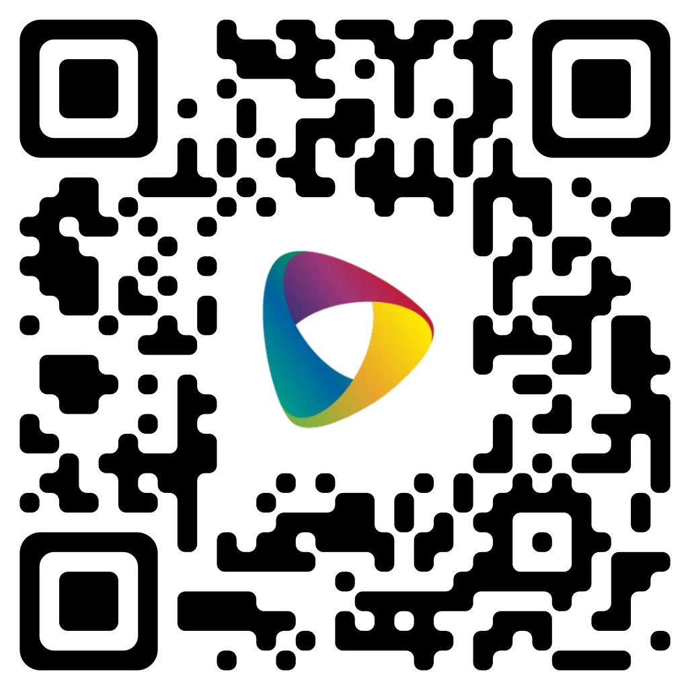
How to Clock In with the NextCrew Mobile App
From the app home
page tap on Clock-In/Out
2. Tap CLOCK-IN
on your timecard
3. Tap CLOCK-IN You may be required to accept permissions to ALLOW camera and location service
Download The App
Please note if either of these are red you will not be able to clock in.
Work Location distance means you are not at the correct location.
Time of clock in means the shift has not started yet or you selected the wrong timecard to clock into.
Open Article Online

Slide 2
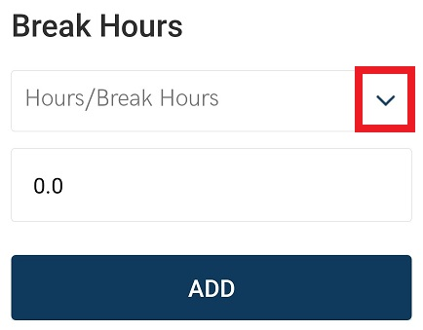
How to add a Break NextCrew Mobile App
1. If a break needs to be added please tap on the break icon
2. Tap on Hours/Break Hours drop down
3. Select one of the following:
(15 minutes)
(30 minutes)
(45 minutes)
(60 minutes)
4. Tap ADD to save
Download The App
Open Article Online

Slide 3
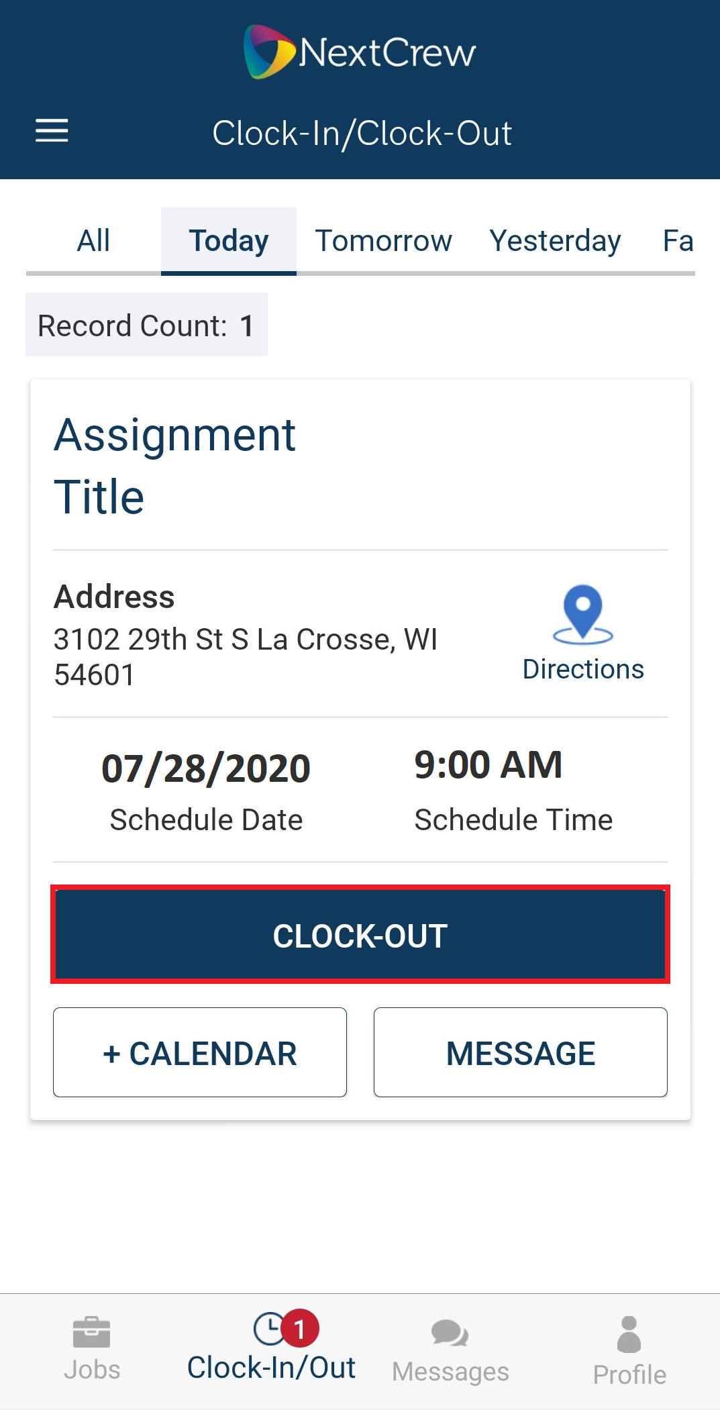
How to Clock out with the NextCrew Mobile App
From the app home
page tap on Clock-In/Out
2. Tap CLOCK-Out
on your timecard
3. Tap CLOCK-Out
Download The App
Open Article Online

